Slide 1
Using RNN for Price Direction Prediction of Cryptocurrencies

Slide 2
Overview
Volume; High, Low, Open, Close Prices of 4 Cryptocurrencies, viz. BTC-USD,LTC-USD,BCH-USD,ETH-USD recorded every minute
A sequence consisting of volume and close prices for all 4 cryptocurrencies over window of time, say 60 minutes, is prepared
An LSTM model is designed to use the sequences to predict if price of a particular cryptocurrency will go higher or lower after some time, say 3 minutes.
A validation accuracy of 57% on an average was reached which is better than random guessing. More tweaking of the model parameters could lead to better accuracy.

Slide 3
Data
Source: https://pythonprogramming.net/static/downloads/machine-learning-data/crypto_data.zip
X: a sequence consisting of volume and close prices of 4 cryptocurrencies over a window of 60 minutes
Y: Buy if price increases in the next 3 minutes, Don’t buy otherwise
Train and Validation datasets were balanced by selecting even number of examples for each class.

Slide 4
Model
The model was designed with 2 layers of 128 LSTM units, 1 layer of 32 ReLUs and output layer of 1 sigmoid (binary classification) unit.
Each layer had a 20% Dropout and BatchNormalised
The model was trained for 10 epochs using Adam optimiser and batch size of 1000

Slide 5
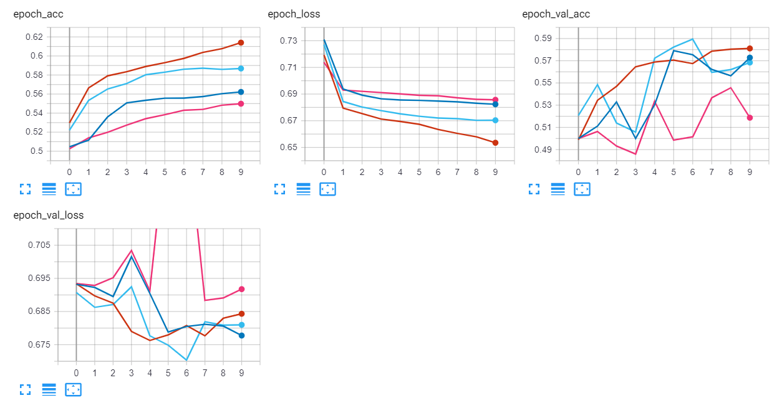
Results

Slide 6
Conclusion
Looks ok. Probably accuracy can go over 60% with some hyper-parameter tuning
Harnessing GPUs can make the process much faster; use CuDNNLSTM instead of LSTM.
Finance is hard ☹ Historical results are not indicative of future results.

